Slide 1

Sentiment Analysis
Standford NLP
Student: Bujor Tiberiu-Cosmin
Teaching Assistant: Aleksandar Karadimce
Assistant Professor: Eustrat Zhupa

Slide 2

Table of contents
What is sentiment analysis
How can we use it?
Implementation
Conclusions

Slide 3
sentiment analysis,
What is?
Sentiment analysis -refers to the use of natural language processing, text analysis, computational linguistics, and biometrics to systematically identify, extract, quantify, and study affective states and subjective information.
Sentiment analysis aims to determine the attitude of a speaker, writer, or other subject in regard with some topic.
Sentiment analysis basic task is to classify the polarity of a given text: document, sentence, or feature/aspect level writing and, informing us whether the expressed opinion is positive, negative, or neutral.

Slide 4
How can we use it?
In many social networking services, users often indicate their political views, their preference in music, food, goods and many other personal opinions than can be used to create graphs, pools, and studies which help create a general opinion and can help in making future changes.
In many social networking services or E-commerce websites, users can provide text review, comment or feedback to the items.
These user-generated text provide a rich source of user's sentiment opinions about numerous products and items.
Potentially, for an item, such text can reveal both the related feature/aspects of the item and the users' sentiments on each feature.
For one week in 2012, Facebook ran an experiment on some of its users in which it altered the algorithms it used to determine which status updates appeared in the news feed of nearly 700,000 randomly selected users based on the post’s emotional content.
Posts were determined to be either negative or positive and Facebook wanted to see if it could make the selected group sad by showing them more negative posts in their feed. It deemed it could. Link to leaked document

Slide 5
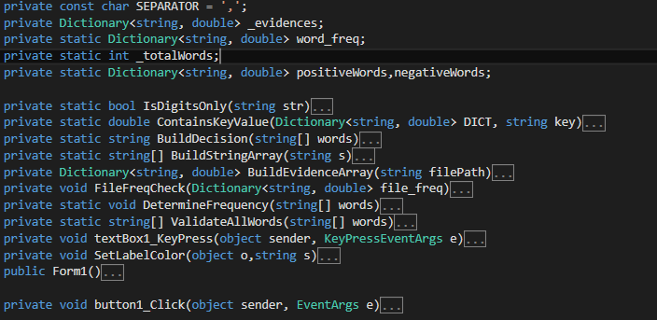
Implementation
All the functions and variables in the program
The main type that I used is Dictionary
Everything is written in ~200 lines, excluding the form

Slide 6
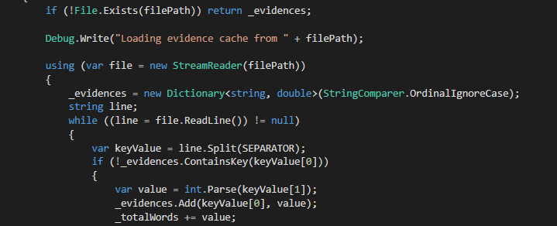
Implementation
A basic read from file that looks for the separator “,” between the key (keyValue[0]) and the value (keyValue[1])
I used .Split that selects everything until the SEPARATOR is met
.ContainsKey and .Add from System.Collections.Generic are specific Dictionary functions

Slide 7
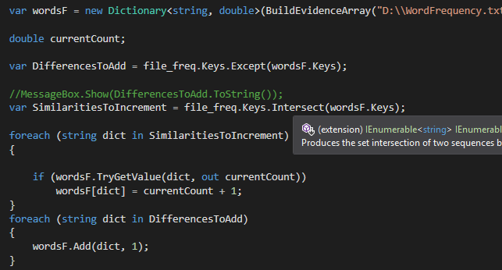
Implementation
Comparing two Dictionaries and modifying a new one

Slide 8
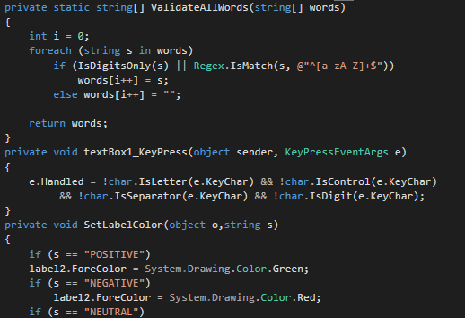
Implementation
Validation of input phrase.

Slide 9
CONCLUSIONS
Sentiment analysis is very useful when you want to improve a product by knowing what the customers want.
Sentiment analysis is the very future of artificial intelligence and understanding human communication patterns.
Sentiment analysis can be used to predict future elections, marketing sales, behavior, etc.
Sentiment analysis is hard to implement because the engineer requires years of training and a very good understanding of human psychology.

Slide 10
REFERENCES
https://stanfordnlp.github.io/CoreNLP/
Taboada, Maite; Brooke, Julian (2011). "Lexicon-based methods for sentiment analysis“
Pang, Bo; Lee, Lillian (2008). "4.1.2 Subjectivity Detection and Opinion Identification“
Volcani, Yanon; & Fogel, David B., "System and method for determining and controlling the impact of text", published June 28, 2001.

